Slide 1
Thread Scheduling

Slide 2
Overview
Thread scheduling
Thread and context switch
Thread creation and termination
Kernel threads vs. user threads

Slide 3
Overview of Threads
A thread is an independent stream of instructions
Threads are multiplexed onto a CPU
Requires
Choosing which thread to run & when
Switching threads
Next we will see how this is done
T1
T2
switch
suspend
resume
switch
suspend
resume
switch

Slide 4
Thread Scheduling
Thread scheduling means running threads in some order
A scheduler decides which thread to run based on
Thread state
Various scheduling policies (discussed later)
A thread has several states
Running - thread is using CPU
Blocked - thread is waiting for some event, e.g., input
Ready - thread is ready to run (neither Running or Blocked)
Exited - thread has exited but not been destroyed
Scheduling functions change the states of threads

Slide 5
Thread Scheduling Functions
Thread_yield - Current thread yields CPU
State change: Running → Ready, e.g., ?
Run another thread: Ready → Running
Thread_sleep - Current thread blocks for an event
State change: Running → Blocked, e.g., send to full buffer
Run another thread : Ready → Running
Thread_wakeup – Wakeup another thread blocked on event
State change: Blocked → Ready, e.g., receive from non-empty buffer
Running
thread_exit
Exited
thread_destroy
thread_sleep
thread_yield
run
Blocked
Ready
thread_create
thread_wakeup
Notes:
thread_yield: a thread may call yield to let other threads run. As we will see later, the scheduler can force a thread to call thread_yield as well.
How do we get to “Running” state? As a result of thread_sleep or thread_yield, the scheduler will run another thread. Note that on a thread_wakeup, the current thread wakes up another thread by moving it to the ready queue, but the current thread continues running.
after thread_exit, a thread is never run again. thread_destroy destroys any state associated with a thread. we will see later why there is a distinction between thread_exit and thread_destroy, i.e., why the thread is not destroyed the moment it exits. Roughly speaking, destroy cannot be done immediately on exit or else code running destroy would destroy its own stack.

Slide 6
Invoking Thread Yield
main() {
thread_create(workerA);
thread_create(workerB);
}
workerA() {
do_A();
thread_yield();
do_more_A();
}
workerB() {
do_B();
thread_yield();
do_more_B();
}

Slide 7
Preemptive Scheduling
A thread may never call thread_yield or thread_sleep
A thread makes these calls voluntarily, when convenient
Scheduler uses timer interrupt to regain control
Interrupt handler calls yield on behalf of current thread
This is called preemptive scheduling
Current thread is preempted at an arbitrary instruction
Running
thread_exit
Exited
thread_destroy
thread_sleep
preemptive
thread_yield
run
Blocked
Ready
thread_create
thread_wakeup
Notes:
preempted: forced out
recall that normally an interrupt handler runs some code and then returns to the original code, so that the original code is not aware that the interrupt handler code ran. in this case, the interrupt handler doesn’t return to the original code. Instead, it calls thread_yield.

Slide 8
Scheduler Implementation
Scheduler maintains thread structures in queues
Ready queue (also ready list) has threads in Ready state
Scheduler calls dequeue to run thread
Wait queue has threads in Blocked state
Typically, a separate wait queue is used for each type of event
E.g., disk, console, timer, network, etc.
Exited queue has threads in Exited state
Scheduling functions move threads between queues
E.g., wakeup moves thread from wait queue to ready queue
Ready
queue
head
thread_id = 5
CPU_regs
state = ready
…
thread_id = 8
CPU_regs
state = ready
…
thread_id = 3
CPU_regs
state = ready
…
Null
Notes:
Note that each queue has threads in the same state, e.g., ready queue has threads in ready state. When the scheduler stops the currently running thread (thread_yield), it will generally move it to the back of the ready queue. Then it picks the thread at the head of the ready queue to run. This ensures that all threads run in round-robin order, getting CPU fairly. We will see this in more detail when we discuss CPU scheduling policies.
The blocked threads could be put in one wait queue, but it is more efficient to put them in a per-event wait queue.
Generally, for efficiency, there is one ready queue per CPU, but the wait and exited queues are global (not per-CPU).

Slide 9
Invoking Thread Sleep & Wakeup
wait_queue wq;
main() {
thread_create(workerA);
thread_create(workerB);
}
workerA() {
do_A();
thread_sleep(wq);
do_more_A();
}
workerB() {
do_B();
thread_wakeup(wq);
do_more_B();
}
Notes:
Notice wq is a global variable. This allows threads to share this queue.

Slide 10
Thread Switching
Thread abstraction requires switching (suspending and resuming) threads
This implementation is tricky, often mysterious …
Let’s see how it works for thread_yield, thread_sleep is similar
// “current” is thread struct for currently running thread
thread_yield()
{
…
// enqueue current in ready queue
// choose next thread to run, remove it from ready queue
next = choose_next_thread();
// switch to next thread
thread_switch(current, next);
…
}
Notes:
thread_yield should be run in a critical section. we will see later on what that means.

Slide 11
Thread Switching
Restore resumes the next thread at the point where the next thread’s state was previously saved
Could this cause a problem?
Process switch requires changing address space as well, called a context switch
context switch = thread switch + address space switch
// call is invoked by one thread but returns in another!
thread_switch(current, next) {
// save current thread’s CPU state
save_processor_state(current->cpu_regs);
…
// restore next thread’s CPU state
restore_processor_state(next->cpu_regs);
}
Notes:
problem: when the next thread starts running, it will appear that it returned from the call to save_processor_state (a second time, think about the thread switch diagram in slide 3, after switch, there are two arrows, one to the next thread, the other to the same thread going down), and will call restore_processor_state again. at this point, the next variable (it is a local variable) will hold the value of the thread to which this thread had last switched to. So we will switch to the next thread. Essentially, we will keep looping between save and restore state.
Another way to think about what is happening: imagine that save_processor_state and restore_processor_state are single instructions.
save_processor_state will save the pc of the following instruction, i.e., store PC to mem.
Restore_processor_state will jump to this instruction, i.e., load from mem to PC
Since PC points to the next instruction after save, the code will loop between the pc following the save_processor_state instruction and the restore_processor_state instruction.
We need some way to distinguish between the first and the second return from save_processor_state, so that the second time, we don’t call restore_processor_state. Hint: remember that current and next will be using two different stacks, so the value of any local variable in this function will depend on which thread is running. Similarly, you could track progress in the thread structures of current and next.
address space switch is implemented by updating the MMU state

Slide 12
Thread Creation and Termination
API functions
thread_create: create a new thread
thread_exit: terminate current thread
thread_destroy: deallocate state for thread
thread_create
A thread creates a new thread by calling thread_create
Allocates thread struct, allocates stack memory, init PC, SP
Sets thread state to READY, and adds it to run queue
Issue 1: If a thread creates a new thread, then who creates the first thread, and how?
Issue 2: We have seen how a thread resumes running, but how does a new thread start running?
Notes:
When the program/OS starts, the current stream of instruction is the first thread. For example, in the thread_sleep and thread_wakeup code shown earlier, we have three threads, the main thread, and threadA and thread. The code should create a thread struct for the “main” thread, so that we can resume its execution when no other thread is running. A new stack is not allocated because the code is already executing on the current stack. So the first thread is “custom” created?
new thread: note that in thread_create, we set the program counter to the starting instruction of the thread code, the stack pointer to the top of the stack, and the thread is set to ready state. the current thread (that called thread_create) then continues to run. At some point in the future, the scheduler will choose to run the new thread, and it will start running it by “resuming” the thread.

Slide 13
Thread Creation and Termination
thread_exit
Current thread invokes this call to terminate itself
On exit, thread is suspended but not resumed
Call does not destroy the thread structure and thread stack
Current code is running on that stack, so destroying it could cause serious corruption
Switch to another thread
thread_destroy
Invoked by thread that starts running after the exited thread
Destroys thread structure and stack of the exited thread

Slide 14
Kernel vs. User Threads
We have discussed how a thread scheduler works
The thread scheduler is implemented in the kernel
The corresponding threads are called kernel threads
Kernel threads virtualize CPU
It can also be implemented by a user program
These threads are called user threads
User threads virtualize a kernel thread

Slide 15
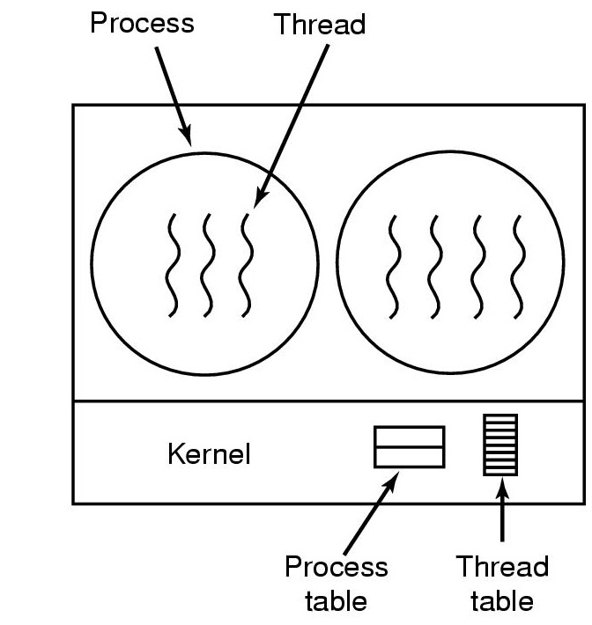
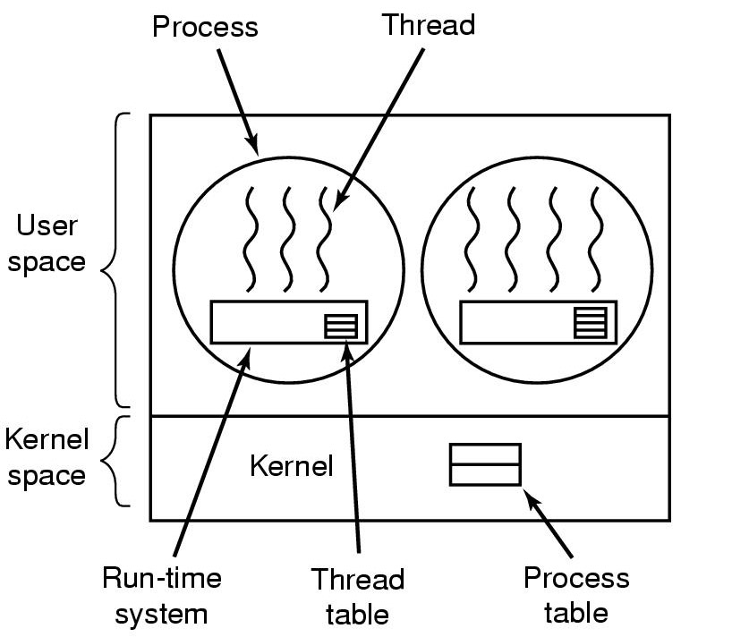
Kernel vs. User Threads
Program
Program
Kernel-level
scheduler
User-level
scheduler
Thread
Kernel Threads
User Threads
Notes:
With kernel threads, the kernel-level scheduler knows about the 7 kernel threads shown.
With user threads, the kernel-level scheduler know about 2 kernel threads. The first kernel thread knows about 4 user threads, the second kernel thread knows about 4 user threads. The kernel scheduler does not know about the user threads.

Slide 16
Kernel vs. User Threads
 | Kernel Threads | User Threads
Switching cost | Kernel switches threads, requiring running kernel code, more expensive | Program switches threads, time closer to procedure call, less expensive
Scheduling policy | System has fixed policies | User can define custom policy
Blocking system calls | When system call blocks (in kernel), kernel switches to another thread | When system call blocks, all user threads (associated with the corresponding kernel thread) block, so overlap of I/O and computation is not possible
Multiprocessors | Different kernel threads can use multiple CPUs concurrently | Different user threads (associated with a given kernel thread) cannot use multiple CPUs concurrently

Slide 17
Summary
The core of an operating system is a thread scheduler
It implements the thread abstraction, and thread switching
Creating and destroying threads introduces some complications
Just like the OS, a user program can also implement a thread scheduler

Slide 18
Think Time
What steps are involved in switching the CPU from one process to another?
What is the difference between a context switch and a mode switch?
What is the difference between a thread switch and a context switch?
Notes:
process swiching: thread and MMU state needs to be saved and restored
difference between context switch and mode switch: they are unrelated, context switch switches threads, mode switch changes the CPU mode
difference between context switch and thread switch: context switch = thread switch + MMU switch, MMU switch generally is much more expensive than thread switch

